Slide 1
HDSL Team Activation Manual

Slide 2
HDSL Team Pre-Season Tasks
Each coach or manager has to perform the following tasks before the season starts
Activate their My Team account
Enter their player roster
Enter their shirt #’s
Ask your assistant coach or team manager to also activate the My Team account

Slide 3
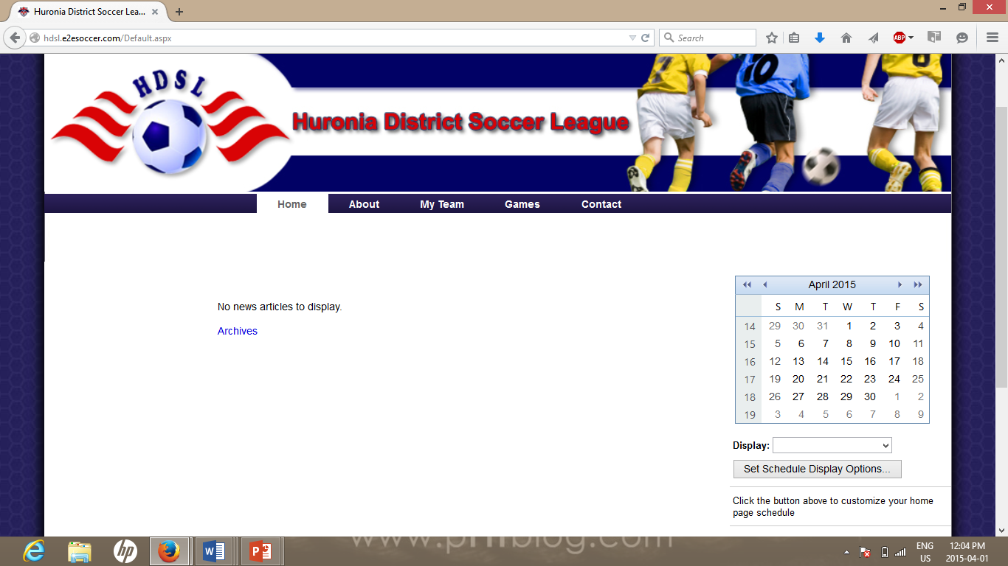
HDSL Home Page
Home page displays plenty of information prior to even logging in.

Slide 4
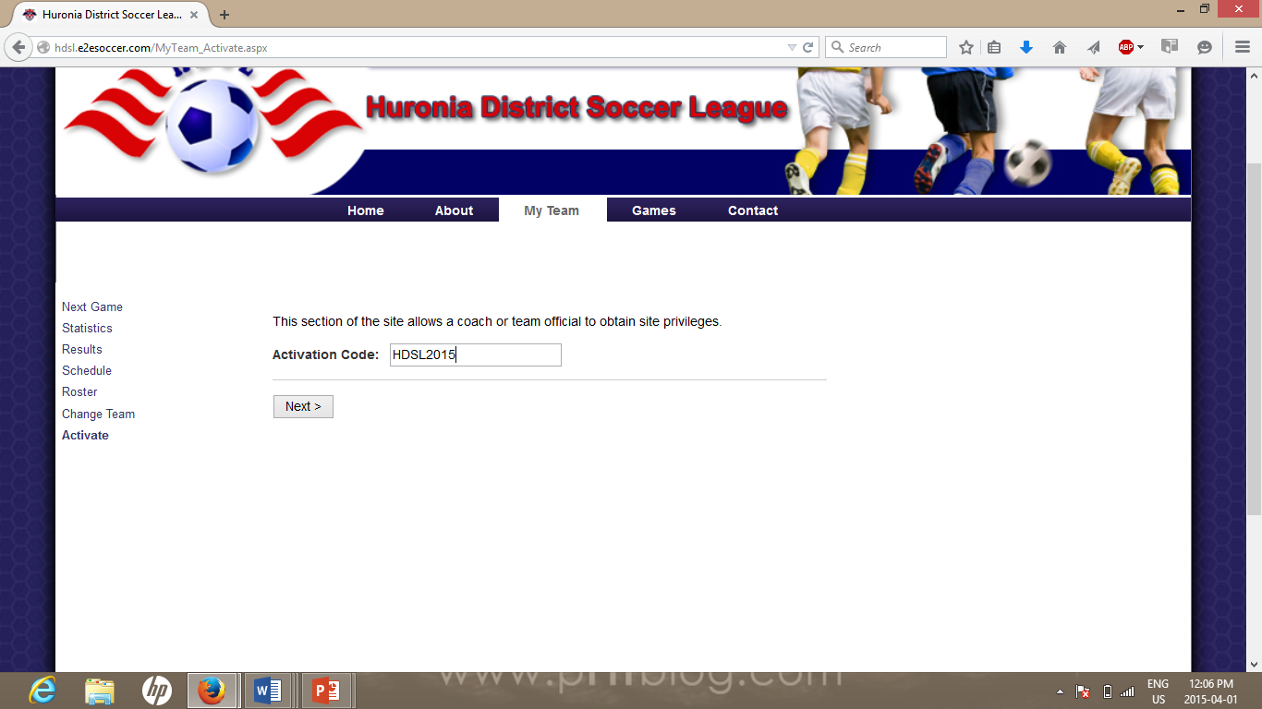
Activating Your Team Account...1
Click on the My Team button
Click on the Activate link
You will be asked to enter an activation code.
This years activation code is:
HDSL2015
Click Next to continue

Slide 5
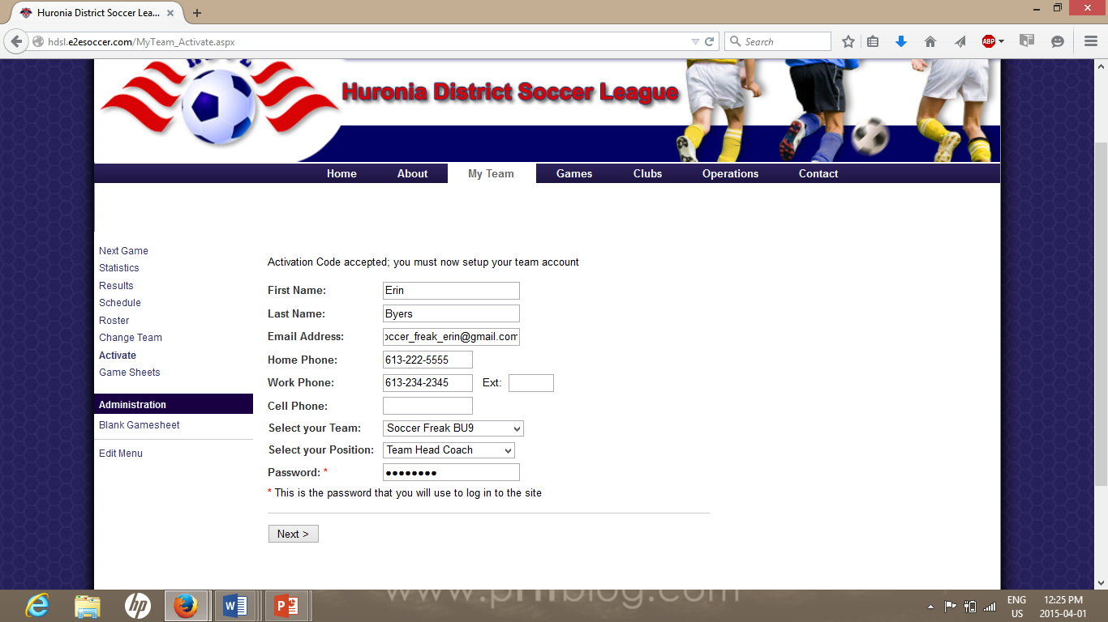
Activating Your Team Account...2
Next you will be asked for your details.
Please ensure that you select the correct team, other teams have similar names
Enter your telephone # in the format
613-123-4567
Finally you will be asked for your password. This is what you will use to log into the site in the future
Click next to continue

Slide 6
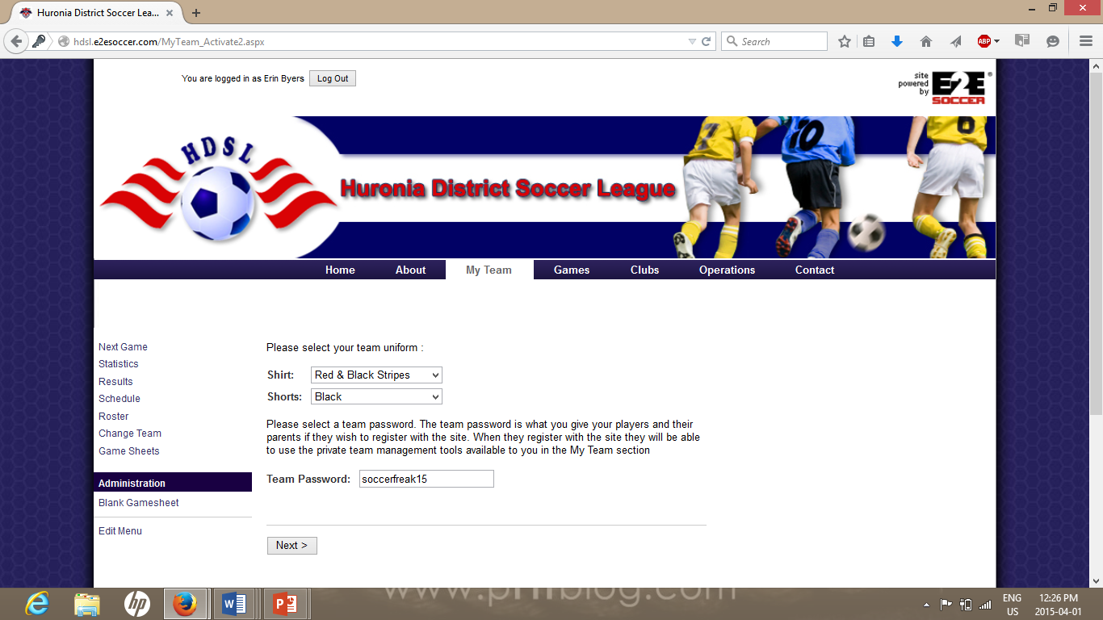
Activating Your Team Account...3
Select your shirt and short colour from the drop down menu
Enter a team password for each registered player to use to access the team information.

Slide 7
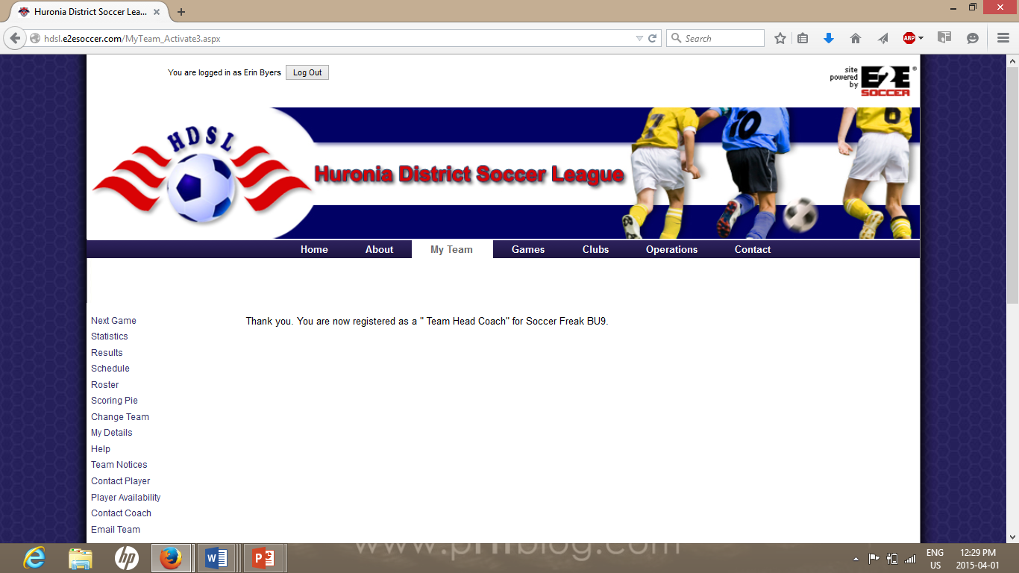
Activation Completed
When you have finished the activation process you will see this screen.
Note that you will see some more tools.
To add an additional team contact, they will need to follow the same process.

Slide 8
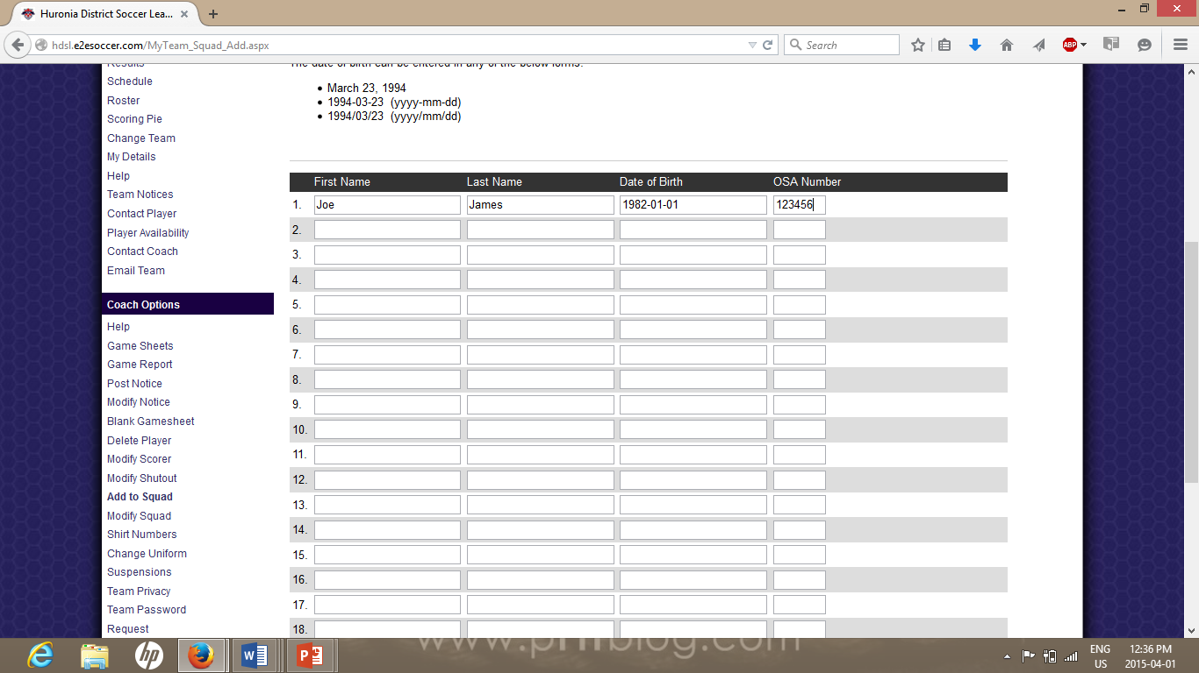
Adding Players
Click on Add to Squad
Enter each players first and last name
Click Submit
This will allow your players names to appear on your gamesheet.

Slide 9
Shirt Numbers
Update each players shirt number.
Click Submit
This will automatically populate on the gamesheet.

Slide 10
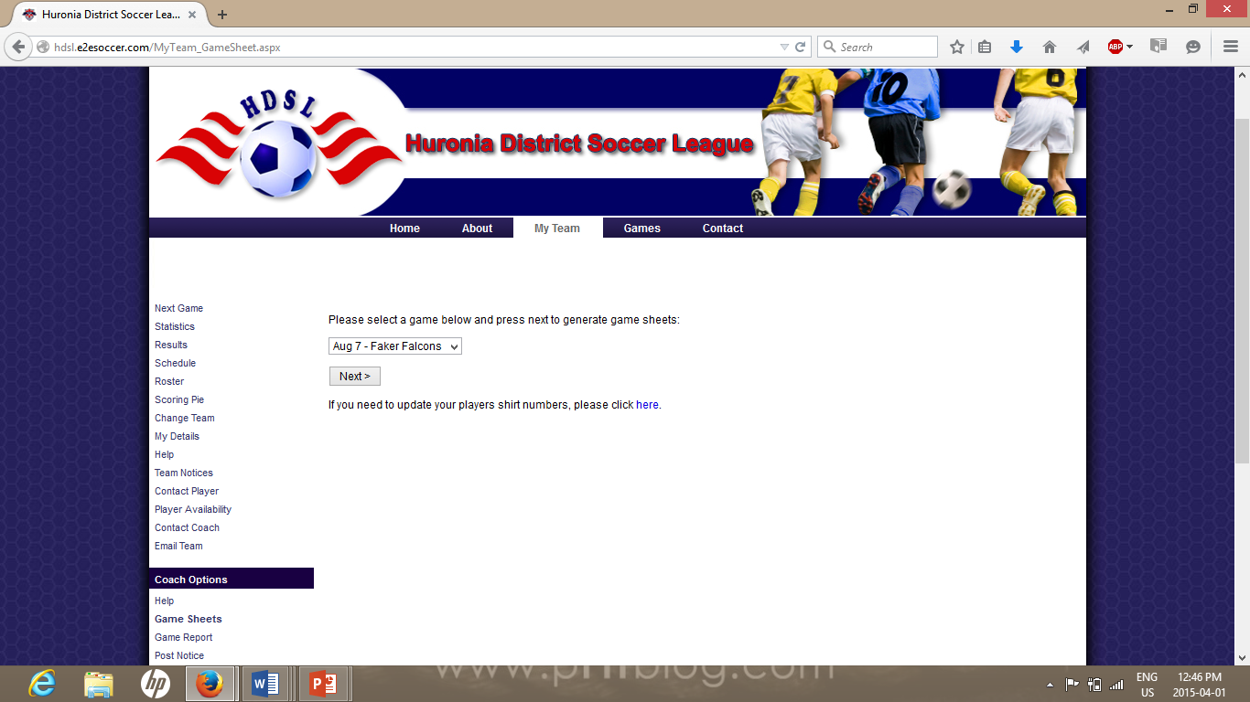
Game Sheets
Your next game will be listed in the pull down menu.
If you need to update more shirt numbers click on link.
To generate the game sheet, click next.

Slide 11
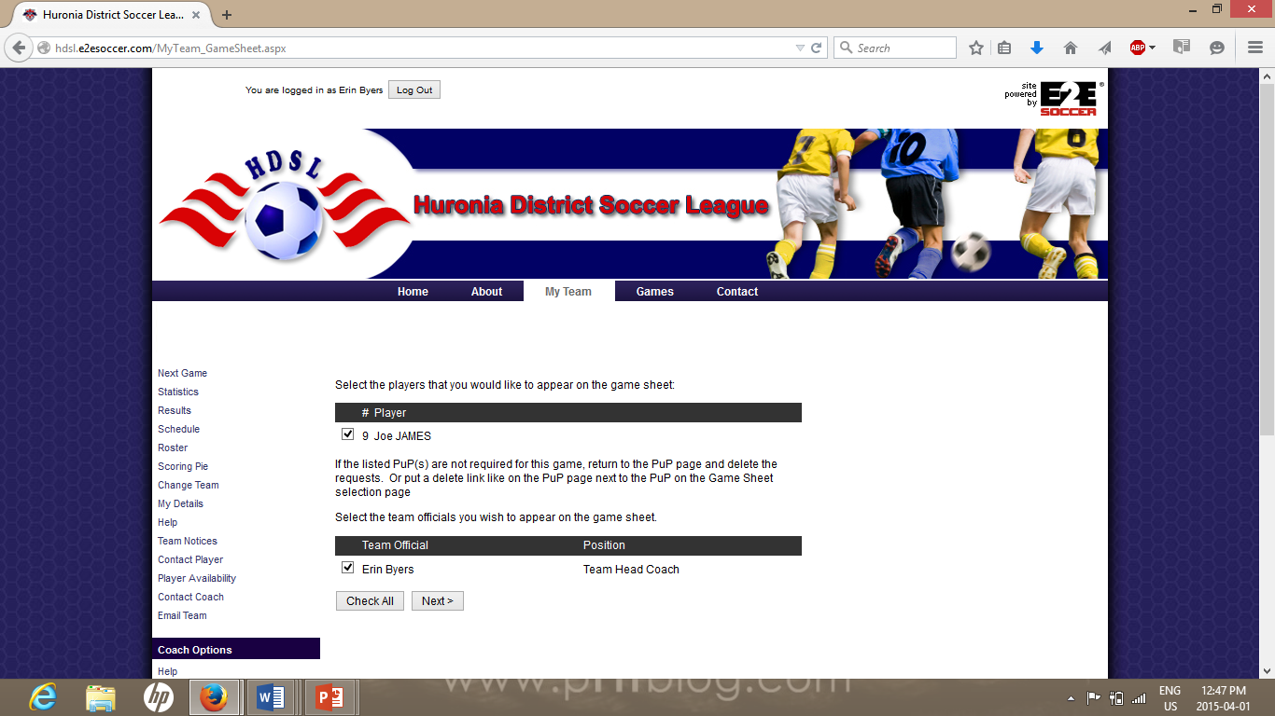
Game Sheet Part 2
Select all your players who will be attending the game.
Click Next

Slide 12
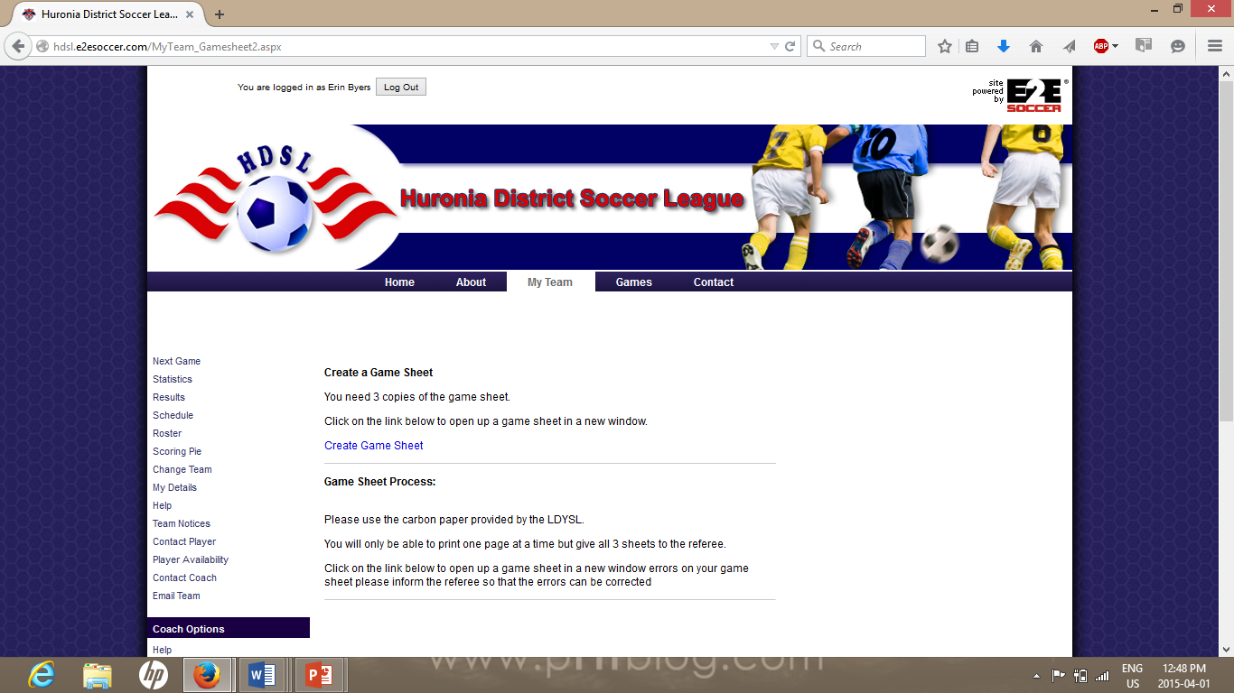
Game Sheet Part 3
Click on create game sheet

Slide 13
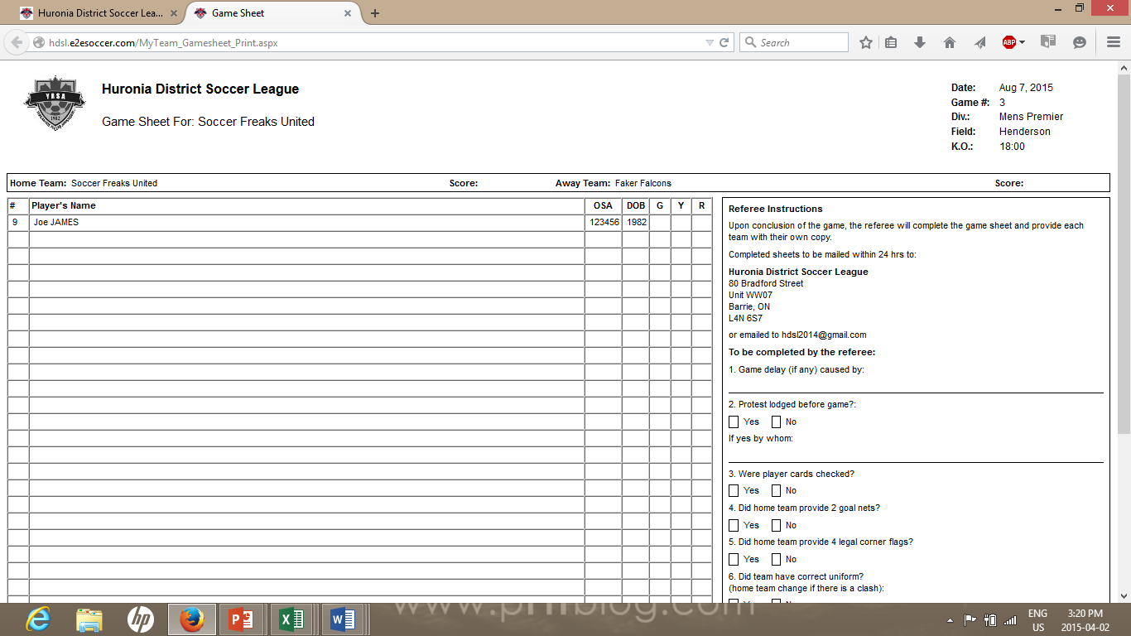

Slide 14
Further Information
Please contact the HDSL for further questions.

